Slide 1
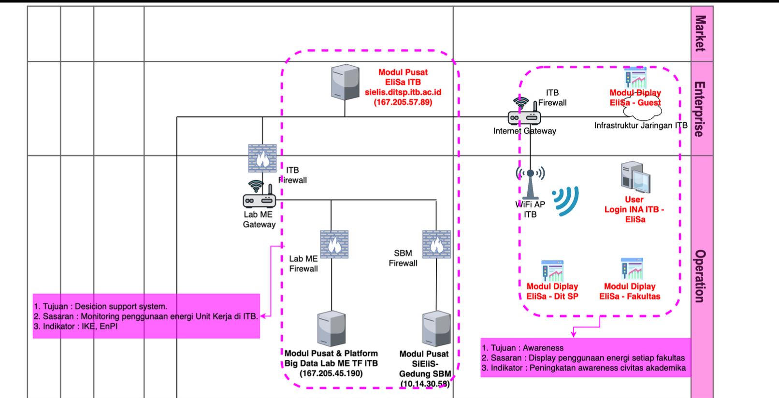
Assignment: SGAM Revision (Gambar Kerja)
Replace
sielis.ditsp.itb.ac.id
167.205.57.89
with
dev.elisa.itb.ac.id
167.205.194.16
Files (every layers):
GK-SF-A001 Lapisan Bisnis
……….
GK-SF-A005 Lapisan Komponen

